Slide 1

29th ANNUAL GENERAL
MEETING
ANNUAL REPORT PRESENTATION

Slide 2
PRESENTATION OVERVIEW
01
02
Our Legislative Mandate
Our Vision, Mission + Values
03
04
Our Strategy
Our Organization at a Glance
05
06
Unit Report
The Year Ahead
07
Acknowledgements

Slide 3
OUR LEGISLATIVE MANDATE
As per Section 37 of the LRA , the PSCBC’s mandate is to deal with matters that:
Are regulated by uniform rules, norms and standards that apply across the Public Service;
Apply to terms and conditions that apply to two or more Sectors; and
Are assigned to the State as Employer in respect of the Public Service and that are not assigned to the State as Employer in any other Sector.
The Challenge Facing Public Servants

Slide 4
Our Vision, Mission & Values
OUR MISSION
OUR VISION
OUR CORE VALUES
A credible, inclusive, and future-ready bargaining council that promotes social dialogue, good governance, workforce well-being, and sustainable outcomes for
public servants
Inclusivity
Integrity
Fairness
Excellence
Collaboration
To provide a stable and trusted platform for collective bargaining and dispute management in the public service by strengthening sustainable outcomes through
meaningful social dialogue.

Slide 5
Our Current Strategy is based on 4 Strategic Objectives
STRATEGIC OBJECTIVES
Review structures and strengthen collective bargaining processes in the Public Service
Monitor, evaluate & ensure compliance with collective agreements
Develop & implement a dispute prevention strategy that will encompass capacity building of stakeholders & enhance the dispute resolution procedure
Develop & implement a research strategy within the organisation

Slide 6


COLLECTIVE BARGAINING
MANDATE
To provide effective and efficient platforms through which the structures of PSCBC (Council, Executive Committee and Provincial Co-ordinating Chambers) can bargain and conclude agreements on matters of mutual interest within the public service.

Slide 7
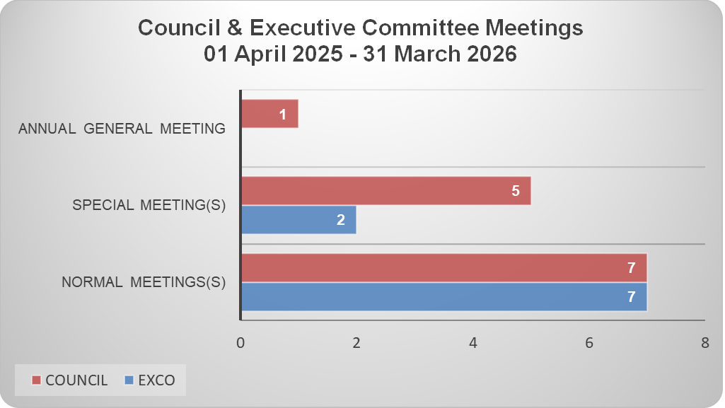
Council & EXCO Meetings

Slide 8
Signed Resolutions
Resolution | Purpose | Objective | Result
1 of 2026 | Agreement on the Increase of Levies | To ensure that the levy fund can maintain the functions of collective bargaining, dispute resolutions, dispute prevention and the operations of the PSCBC | The agreement obtained an 88.37% majority status on 04 March 2026, and was signed by: Employer, DENOSA, HOSPERSA, NAPTOSA, NEHAWU, PSA, SADTU and SAPU

Slide 9
Committees/ Task Teams
Committee | Establishment/ Legislative mandate | Key Focus Areas | Key Highlights | Status as at 31 March 2025
PSCBC GEMS Working Committee | Established in terms of Resolution 4 of 2017 to consider the performance of the Government Employees Medical Scheme (GEMS) on an ongoing basis. | To give effect to the transformation of GEMS allowing the board to reflect the demographics of the membership of the scheme. To improve the healthcare benefits of members and funding for those benefits should be prioritised from the savings incurred by the scheme | The hosting of a workshop on legislation governing medical schemes to better understand the medical schemes’ industry, trends and the Medical Schemes Act, to enable Council to engage with GEMS from an informed position. The satisfaction survey conducted by Council on GEMS PSCBC’s strategic engagement with GEMS on issues of affordability, access and transformation | Council to consider the report from the strategic engagement with GEMS and agree on a program of action.

Slide 10
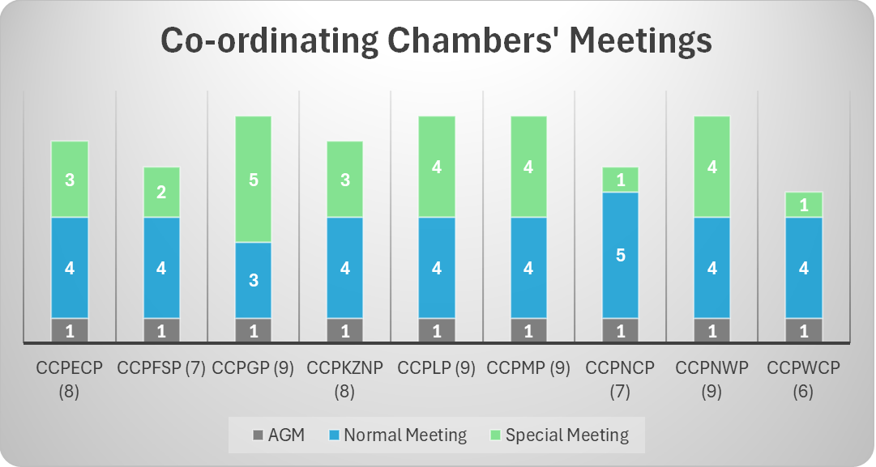
Coordinating Chambers of the PSCBC

Slide 11
Capacity Building for Parties to Council and Chambers
CHAMBERS
PSCBC Workshops on the 2025/2026 Wage Negotiations Agreements
During the previous reporting period, the PSCBC began conducting workshops on Resolutions 1 and 2 of 2025, both arising from the 2025/2026 wage negotiations. This initiative aimed to ensure consistent understanding and implementation of these resolutions. The program continued into the current reporting period, with additional workshops rolled out in the Mpumalanga, Eastern Cape, Northern Cape, Free State, and Western Cape provinces.
PSETA Training Initiatives
Through the Trade Union membership Management section of the Unit, the PSCBC Chambers participated in several training
initiatives through a partnership with the GPSSBC, PHSDSBC, and the PSETA. These included the following:
Non-pivotal Dispute Management and Negotiation Skills Training
Apply Public Service Labour Legislation in Mediation (US ID 119954)

Slide 12
Capacity Building for Parties to Council and Chambers
7TH ALLS Conference 25-26 February 2026, Gaborone Botswana
The African Labour Law Society (ALLS) is a professional association dedicated to the advancement of labour and employment law across the continent. Its primary objectives are to enhance legal expertise,
facilitate knowledge sharing among members, and encourage cross-border jurisdictional learning. As an affiliate, the Council sent a delegation of 21 members to this year’s conference, which was held on 25 and 26 February 2026, at the Grand Palm Conference Centre in Gaborone, Botswana.
Held under the theme "Balancing Rights and Responsibilities in the Modern African Workplace", the event provided invaluable insights and was highly regarded by delegates for its comprehensive and eye-opening perspective on evolving workplace dynamics.

Slide 13

DISPUTE MANAGEMENT
MANDATE
To perform dispute resolution functions in terms of section 127 of the Labour Relations Act 66 of 1995 as amended

Slide 14


Key Highlights
PSCBC PORTAL
The PSCBC Portal is an advancement to the Council’s automated business management system. The Portal extends to functions which allow panellists and parties to connect to the internal business management system and interact with processes in real-time.
MONITORING & ENFORCEMENT OF COLLECTIVE AGREEMENTS & RULES
The Council, empowered to monitor and enforce the collective agreements, concluded and workshopped several collective agreements including but not limited to regulating the enforcement of collective agreement in the public service, namely, Resolution 3 of 2023. Furthermore, the Council has replaced Resolution 4 of 2005, ‘Rules for the conduct of proceedings before the PSCBC’ with the new Rules – Resolution 1 of 2024.

Slide 15
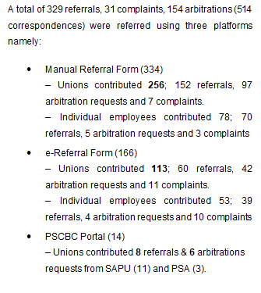
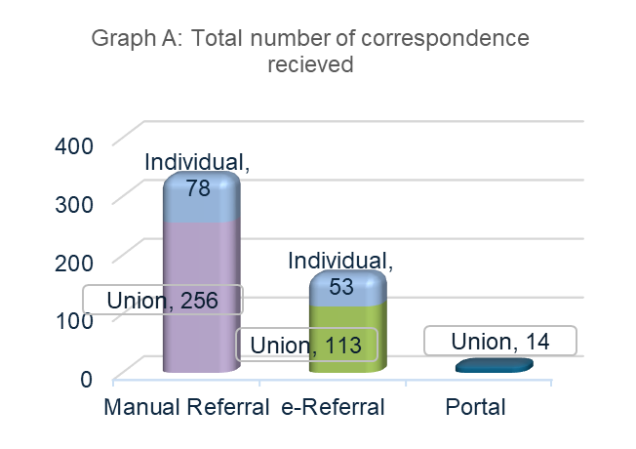
Statistics: Referrals

Slide 16
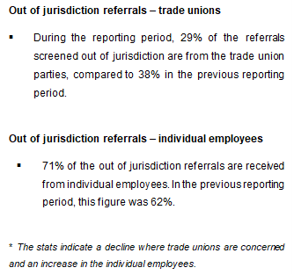
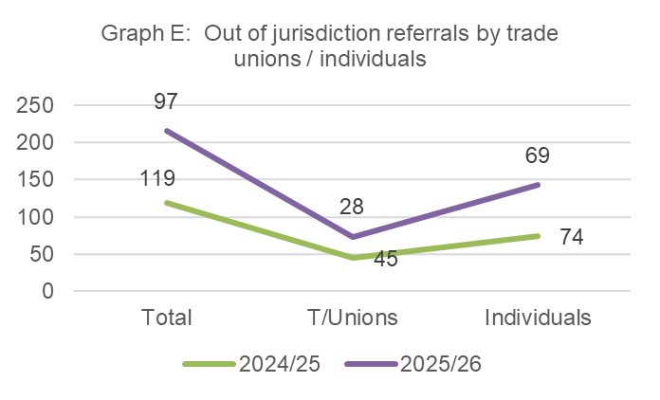
Statistics: Jurisdiction

Slide 17
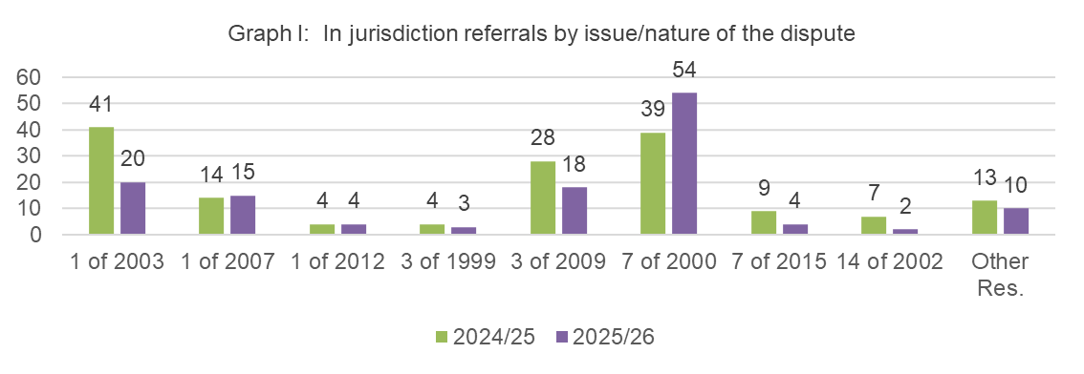
Statistics: By issue
The following PSCBC Resolutions are major contributors in the cases referred-
Disputes relating to Resolution 1 of 20033 account for 15% and 26% in the previous reporting period.
Disputes relating to Resolution 7 of 20004 account for 42% and 25% in the previous reporting period.
Disputes relating to Resolution 3 of 20095 account for 14% and 18% in the previous reporting period.
Disputes referred in terms of Resolution 14 of 20026 has been significantly reduced from 5% in the previous reporting period to 2% in compliance with clauses F8 & F11 of Resolution 14 of 2002.

Slide 18
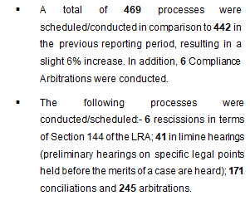
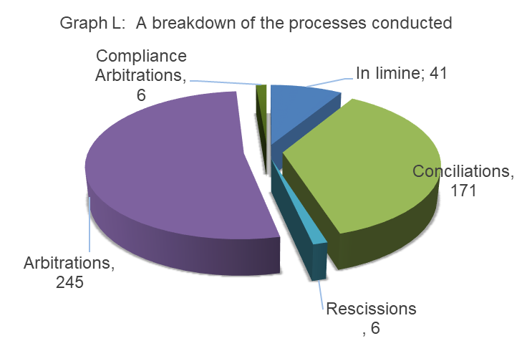
Statistics: By issue

Slide 19
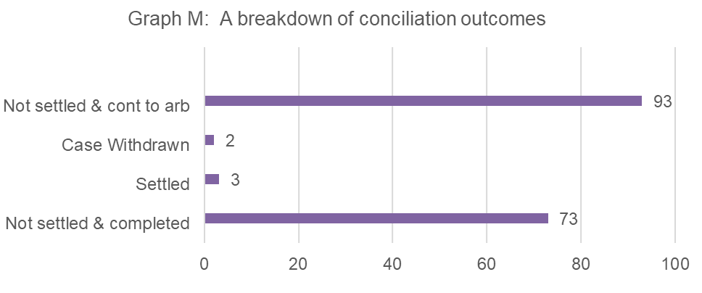
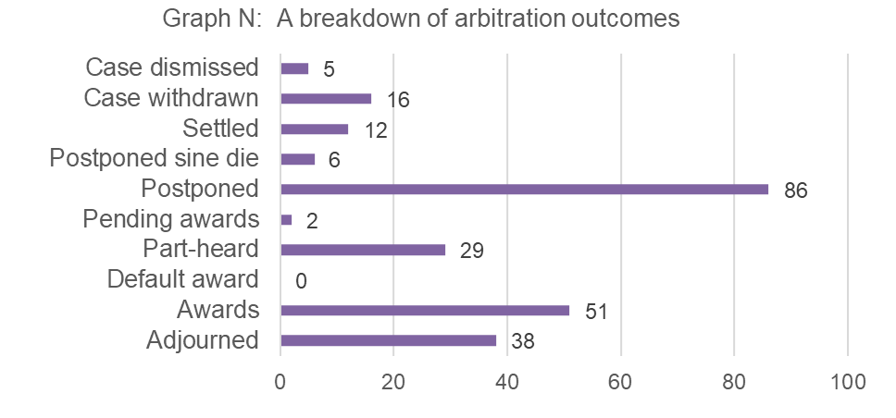
Statistics
At the conciliation phase, 97% of conciliations are unresolved. Of the 97% that remained unresolved, 54% have been referred to arbitration.
The settlement and withdrawal rate at the conciliation level were both at a 1% each.
The Council conducted 245 arbitration processes. The outcomes from these processes are as follows: 51 awards were rendered, 86 cases were postponed (49 postponed by ruling & 37 by party request), 16 disputes were withdrawn, and 12 settlements were reached.

Slide 20
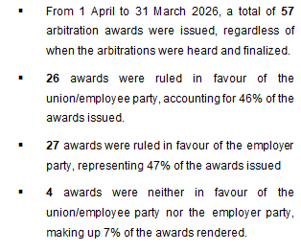
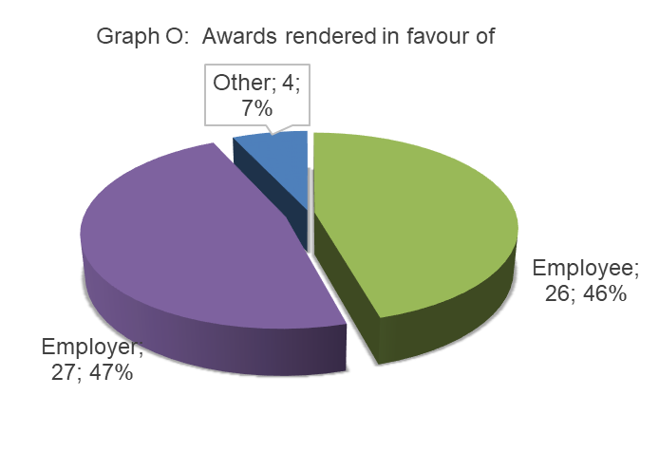
Statistics: Awards

Slide 21
Matters on Review: 1 April to 31 March 2025
Case Number | Outcome | LC Number | PSCBC Resolution/Issue | Reviewed By
PSCBC192-24/25 | Pending Labour Court Appeal | 2025-035520 | Res 01 of 2003 (disciplinary code and procedures) | Applicant party
PSCBC185-25/26 | Pending Labour Court Appeal | 2025-233444 | Res 01 of 2003 (disciplinary code and procedures) | Applicant party
PSCBC102-24/25 | Pending Labour Court Appeal | 2025-234560 | Res 07 of 2000 (leave provisions) | Applicant party
PSCBC169-25/26 | Pending Labour Court Appeal | 2026-047238 | Res 03 of 2009 (grade progression) | Applicant party

Slide 22
Enforcement Complaints
Following the conclusion of Resolution 03 of 2023, the enforcement of Collective Agreements in the public service, a total of 24 enforcement complaints were received during this reporting period.
Since the signing of the resolution, 31 enforcement complaints have been received in total. Of these, 9 were screened to be outside of jurisdiction, 7 are currently under investigation pending resolution, 6 were finalised and closed, 12 were found non-compliant, 1 was compliant and 6 were scheduled for compliance arbitrations.

Slide 23
RESIDENT PANELLIST
MANDATE
Support Council`s strategic goals and objectives by conducting insourced conciliation hearings. Conduct arbitration hearings, deal with preliminary processes and applications that are filed with Council, control the vetting of awards and rulings to ensure quality and legal compliance. Provide guidance and support to panellists. Provide guidance to the Dispute Management Unit, interact with stakeholders in the dispute resolution process and labour relations in general.

Slide 24
A breakdown of attendance of representatives of the Applicant
 | Current Reporting Period |  |  |  | Previous Reporting Period
Applicant | Total Cases | Cases Attended | Cases Not Attended | Attendance Percentage | Total Cases | Cases Attended | Cases Not Attended | Attendance Percentage
INDIVIDUAL | 16 | 13 | 2 | 81% | 9 | 8 | 1 | 89%
DENOSA | 4 | 4 | 0 | 100% | 3 | 3 | 0 | 100%
HOSPERSA | 19 | 14 | 5 | 74% | 8 | 8 | 0 | 100%
NAPTOSA | - | - | - | - | 1 | 1 | 0 | 100%
NUPSAW | 12 | 7 | 5 | 58% | 4 | 4 | 0 | 100%
NEHAWU | 36 | 31 | 5 | 86% | 34 | 33 | 1 | 97%
POPCRU | 14 | 12 | 2 | 86% | 14 | 12 | 2 | 86%
PSA | 57 | 48 | 9 | 84% | 69 | 58 | 11 | 84%
SADTU | - | - | - | - | 1 | 1 | 0 | 100%
SAPU | 20 | 19 | 1 | 95% | 11 | 9 | 2 | 82%
SOLIDARITY | - | - | - | - | 4 | 4 | 0 | 100%
SAOU | - | - | - | - | 1 | 1 | 0 | 100%
SAEPU | - | - | - | - | 1 | 1 | 0 | 100%
TOTAL | 178 | 148 | 30 | 83% | 160 | 143 | 17 | 89%

Slide 25
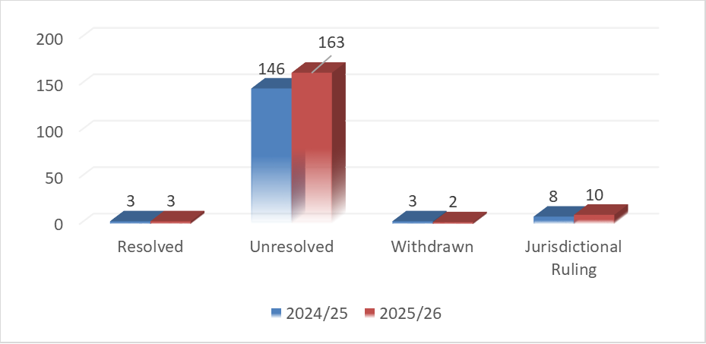

Conciliation and Arbitration Statistics
Outcomes of the conciliations conducted
Comparison of the number of arbitrations conducted

Slide 26
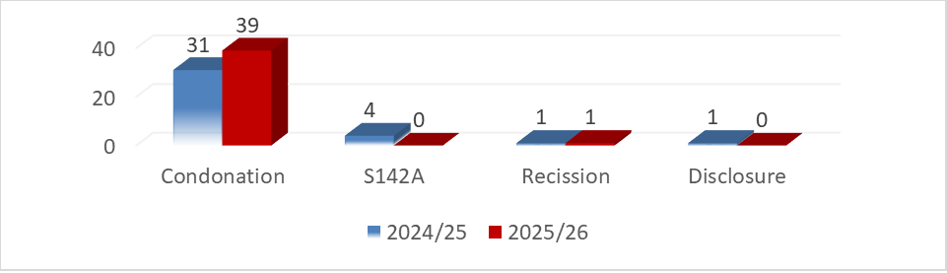
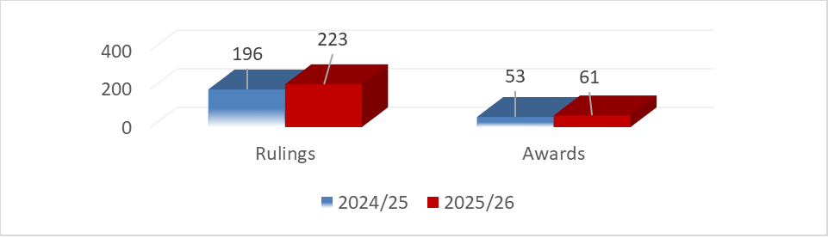
Conciliation and Arbitration Statistics
Outcomes of the conciliations conducted
Comparison of the number of arbitrations conducted

Slide 27

STRATEGIC MONITORING & EVALUATION
MANDATE
To provide a technical support function through the monitoring & tracking of all activities across different structures of Council (Council, EXCO, Chambers, Committees, Units). This includes the development of implementation plans, tracking of associated timelines & reporting thereof. The Unit also guides research & strategic initiatives of the organisation

Slide 28
RESEARCH PROJECTS
TRADE UNION RESEARCH
HEALTHCARE GOVERNANCE RESEARCH
Analysis of Trade Union Dual Membership Trends (Annual)
Analysis of Trade Union Membership Trends (Quarterly)
Agency Shop Agreement Report – Strategic Analysis of Trade Union Recruitment Opportunities
Research on Recruitment Policies in the Public Service – Trade Union Observer Status
Research on Uniform Policies in the Public Service
Government Employees Medical Scheme (GEMS) Review Report
GEMS Customer Perceptions Survey

Slide 29
RESEARCH PROJECTS
SKILLS DEVELOPMENT RESEARCH
TRAINING IMPACT AND PROGRAMME EVALUATION
Public Administration Leadership Training Programme – Longitudinal Study
Impact Evaluation Report – Labour Dispute Training Programme
CCPMP Skills Audit – Mpumalanga Chamber
PSETA Training Initiatives Learner Withdrawal Survey

Slide 30
RESEARCH PROJECTS CONDUCTED AND CONCLUDED
DISPUTE MANAGEMENT RESEARCH
TRAINING IMPACT AND PROGRAMME EVALUATION
Evaluating the Dispute Referral Process
Public Administration Leadership Training Programme – Longitudinal Study
Impact Evaluation Report – Labour Dispute Training Programme
PSCBC Corporate Social Responsibility (CSR) Evaluation

Slide 31
RESEARCH PROJECTS
RESEARCH PROJECTS IN PROGRESS
OVERALL RESEARCH ACHIEVEMNET
Breastfeeding and Child Care Facilities Research
Comprehensive Danger Insurance Research
Bursary Scheme Research
Total Concluded Research Outputs: 13
Total Research Projects In Progress: 3

Slide 32

CORPORATE SERVICES
MANDATE
To enable the PSCBC to achieve its core mandate through the provision of finance, human capital, procurement, logistics & facilities management.

Slide 33
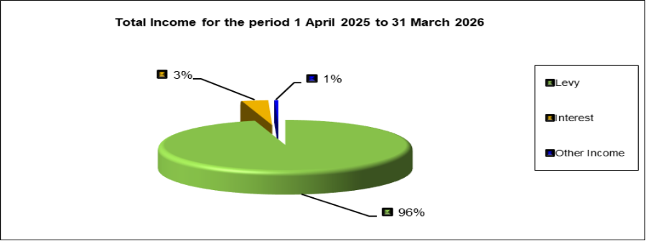
Finance - Income
Total Income – Levy Account
The overall income for the Council during the 2025/2026 financial year was R 55 038 258.27.
The income base remained stable and predictable, with income primarily derived from levies. Total income for the period is categorised as follows:
96% was generated out of the levies from the public service as per Resolution 2 of 2013.
3% was generated from interest earned on levies and accumulated reserves.
1% was generated from other income sources.

Slide 34
HR-Talent Management
STAFF RETENTION
During the period under review, the PSCBC celebrated a 10-year service milestone for six (06) staff members. These milestones are in addition to the more than fifteen (15) staff members who already have over ten years of service within the Council. This achievement not only reflects positively on the individuals concerned, but also strengthens the collective institutional knowledge and organisational continuity within the PSCBC. As a result, approximately 55% of the PSCBC staff complement now comprises employees with more than a decade of service to the Council, demonstrating a strong culture of staff retention and organisational commitment.
APPOINTMENTS
During the period under review, the following appointments were made in a phased approach and in line with the operational requirements of the Council. Furthermore, in support of the operationalization of the Trade Unions Management Sub-unit, Mr. Tseke Mphahlele was promoted to the position of Senior Officer: Trade Unions.
The Council remains committed to filling vacancies in a phased and sustainable manner, subject to operational requirements and organisational priorities. Accordingly, during the period under review, the Council successfully filled six (06) vacancies to ensure the effective implementation and achievement of its strategic objectives.

Slide 35
HR-Talent Management
TERMINATIONS
The Council continued to provide a valuable stepping stone for employees seeking to grow professionally and explore opportunities in other industries and working environments. During the period under review, the Council bid farewell to the colleagues listed below, following the receipt of their resignations.
RETIREMENT
During the period under review, the Council bid farewell to Ms. Jemina Kutumela, who elected to take early retirement after eighteen (18) years of dedicated service to the Council. Ms. Kutumela joined the Council on 01 June 2007 as a Cleaner. Through her hard work, commitment, and willingness to learn, she was appointed in an acting capacity as Receptionist in September 2010 and was subsequently promoted to the permanent position of Receptionist on 01 December 2013, a role she occupied with distinction until her retirement.

Slide 36
HR-Talent Management
VACANT POSITIONS
As a result of the implementation of the adopted organisational structure, as well as resignations received during the period under review, the positions listed below remained vacant as at 31 March 2026. Despite these vacancies, the Council maintained an occupancy rate of 73%, with more than 35 of the 48 approved positions filled. In addition, two (02) more vacancies were approved for appointment in March 2026, which will increase the occupancy rate to 77%. This reflects a 7% improvement from the 70% occupancy rate reported during the 2024/2025 financial year. These figures exclude interns and contractual staff members.
RETIREMENT

Slide 37
HR-Employee Wellness
For the year under review, Council continued to maintain employee wellness interventions introduced in the 2024/2025 financial year. This was achieved through the following initiatives.
Staff Wellness Boards
Wellness Wednesdays, Walk the talk
Staff Year End Appreciation Session
Staff Year end and team building

Slide 38

COMMUNICATIONS
MANDATE
To create a unified and sustainable brand image by communicating clear and concise messages using relevant communication channels. This is with the aim to craft a strong brand for Council and promote it strategically both nationally and internationally.

Slide 39
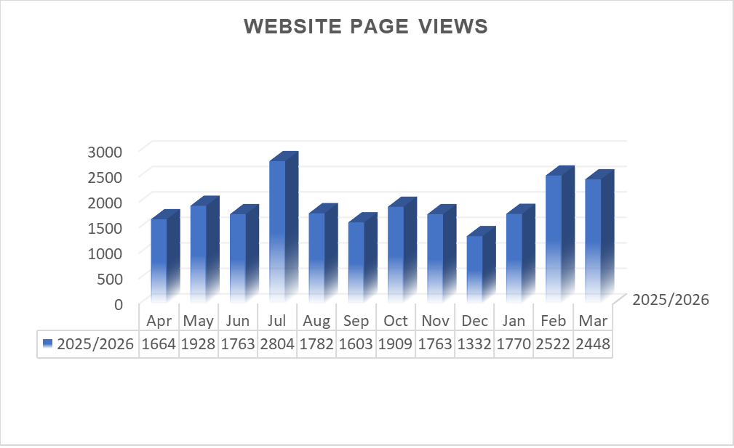
Website Statistics
The graph illustrates the total number of page views recorded on the website during the 2025/2026 financial year, reflecting overall user engagement with the Council’s online content.

Slide 40
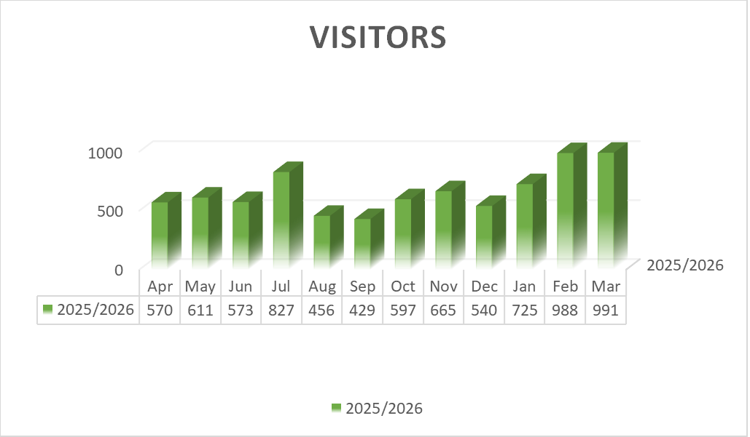
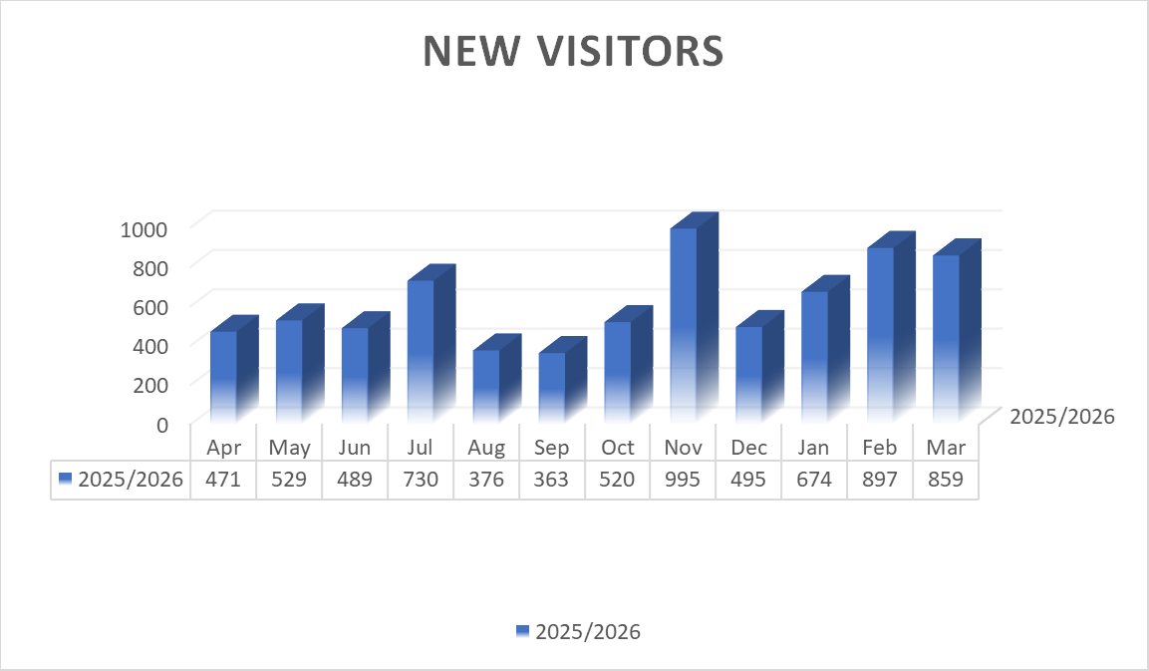
Comparison of Visitors + New Visitors
A cross-comparison of the data reveals that traffic for the 2025/2026 fiscal year is heavily dominated by first-time users, with new visitors consistently accounting for over 80% to 90% of total volume in almost every mapped month. Both charts follow an identical seasonal trajectory, showing a spike in July (730 new vs. 827 total). This is followed by a sharp decline that bottoms out in September (363 new vs. 429 total), before building up to a primary peak at the end of February and March, where overall traffic hovers near 1,000 visitors.

Slide 41
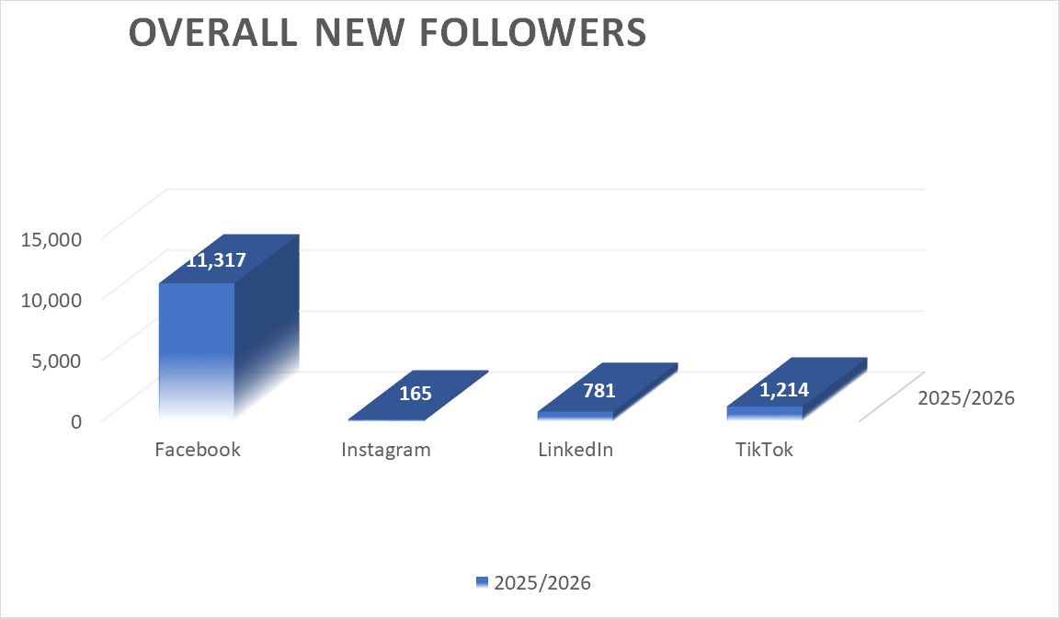
Social Media
A cross-comparison of our social media performance growth in terms of number of followers accumulated for the 2025/2026 financial year demonstrates that Facebook is an absolute powerhouse of your social media ecosystem, accounting for growth of 11,317 new followers out of 13,477 total new followers’ growth. Tik Tok has relatively performed well accumulating 1,214 followers as a new platform introduced from August 2025.

Slide 42
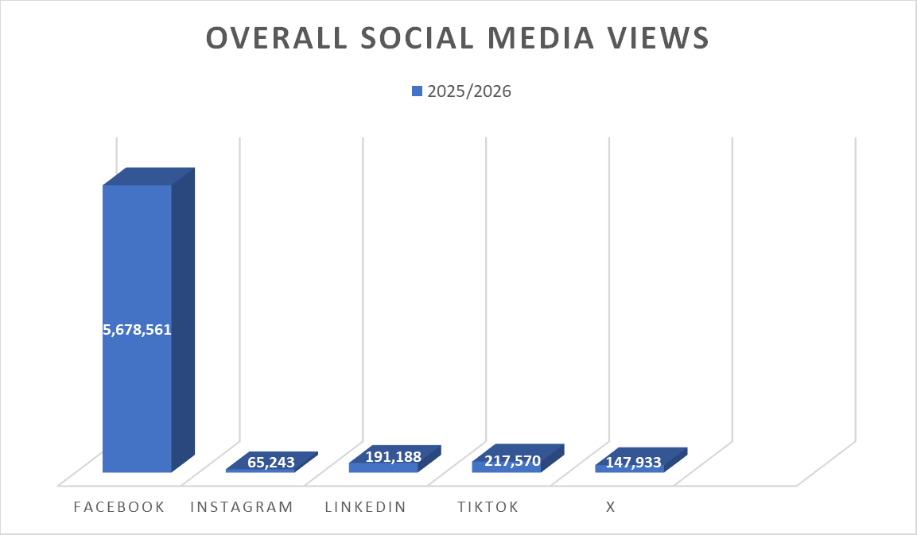
Social Media
In terms of reach, Facebook remains our dominant platform with more than 5 million views. TikTok, a newer channel for the PSCBC, has quickly become our second-largest source of traffic at 217,570 views. LinkedIn shows solid visibility with 191,188 views. X (formerly Twitter) is not currently included in our follower-tracking, yet it delivered a notable 147,933 views, revealing an untracked audience segment that should be monitored. Instagram performs weakest across the datasets, generating only 65,243 views.

Slide 43
EVENTS
CORPORATE SOCIAL RESPONSIBILITY (CSR) EVENTS
67 Minutes of Mandela Day at Bombani Shelter for Abused Women and Children
National Disability Awareness Month Visit to Itereleng Disability Centre
School Uniform Drive at Cothoza Primary School, Mpumalanga
Council and Governance Events
28th Annual General Meeting (AGM)
PSCBC Resolution 1 and 2 of 2025 Provincial Workshops
Conclusion of Provincial Chambers Strategic Planning Sessions and Annual General Meetings
Council Final Sitting and Farewell to Retiring Council Members
PSCBC Strategic Planning Session (March 2026)
PSCBC Labour Parties Caucus
PSCBC Employer Caucus
PSCBC Trilateral Planning Meetings
Management of Trade Union Membership Follow-Up Workshop

Slide 44
EVENTS
Training and Capacity Building Events
PSCBC, GPSSBC & PSETA Graduation Ceremonies
PSCBC/GPSSBC & PSETA Public Service Dispute Management and Negotiation Skills Training
NAPTOSA Staff Training Programme
Health, Wellness and Empowerment Events
International Nurses Day Celebration hosted by DENOSA
International Nurses Day Celebration hosted by NEHAWU
SAPS Mother's Day Celebration
GENES Women Empowerment Programme Graduation Ceremony
PSCBC Men's Mental Health Month Wellness Initiative
Breast Cancer Awareness Event
POPCRU First Annual Wellness Day

Slide 45
EVENTS
Labour Relations and Stakeholder Engagement Events
NEHAWU National Organising, Servicing and Bargaining Conference
National Teachers' Union (NATU) 107th Triennial National Conference
Professional Educators' Union Elective Congress
NAPTOSA 8th National Congress
POPCRU Central Executive Committee Conference
DPSA National Labour Relations Forum
SAPU Book Launch on Gender-Based Violence
Healthcare and GEMS Related Events
GEMS Symposium 2025
FEDUSA-Affiliated Trade Unions March and Memorandum Submission to GEMS
COSATU-Affiliated Trade Unions Media Briefing and Protest Action Against GEMS Contribution Increases
PSCBC Engagements on GEMS Contribution Increases

Slide 46
EVENTS
Labour Relations and Stakeholder Engagement Events
NEHAWU National Organising, Servicing and Bargaining Conference
National Teachers' Union (NATU) 107th Triennial National Conference
Professional Educators' Union Elective Congress
NAPTOSA 8th National Congress
POPCRU Central Executive Committee Conference
DPSA National Labour Relations Forum
SAPU Book Launch on Gender-Based Violence
International and Industry Conferences
ILERA Europa Conference
South African Public Administration and Management (SAPAAM) Summit
Labour Law and Compliance Summit
Trade Union Conference on Gender-Based Violence
14th ILERA European Congress (United Kingdom)
7th African Labour Law Society Conference (Botswana)

Slide 47
EVENTS
Public Service Recognition and Awards Events
Batho Pele Excellence and Innovation Awards
Publications and Knowledge Sharing Launches
Launch of the PSCBC Commemorative Book – From Struggle to Structure: One Agreement at a Time

Slide 48
Acknowledgements
The Chairpersons of Council – Mr Magate Phala, Mr David Phala, Mr. Mompati Galorale,
Members of the Executive Committee and members of Council, thank you for your commitment and support;
My appreciation also to the staff of PSCBC for their relentless commitment, support and hard work.
We look forward to a great year ahead filled with new, redefined & improved ways of working

Slide 49

Thank
You!!

